Slide 1
Liquide

Slide 2

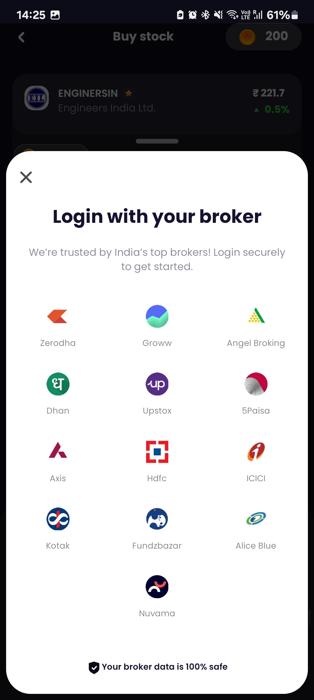
Introduction
Liquide specialized in stock investment advisory and equity research
Registered as Enterprise Research Analyst with SEBI, India
INH000009816
Founders - Anuj Bajpai, Paritosh Gunjan, Kunal Ambasta, Aniket Shirke
Live on a variety of broker accounts - Groww, Zerodha, Dhan, Upstox, AngelOne, 5Paisa
FOUNDED IN
2021, Bangalore
FUNDING
$2.2 Million
USER BASE
1.3M+
MODEL
B2C

Slide 3
Key Features
Stock Market Trading Recommendations
Portfolio Health Analysis
Al-Powered Bot – LiMo
IPO Verdicts
Watchlist Stocks and Stock Alerts
Stock insights and Market Sentiment
Academy
Stock Baskets

Slide 4
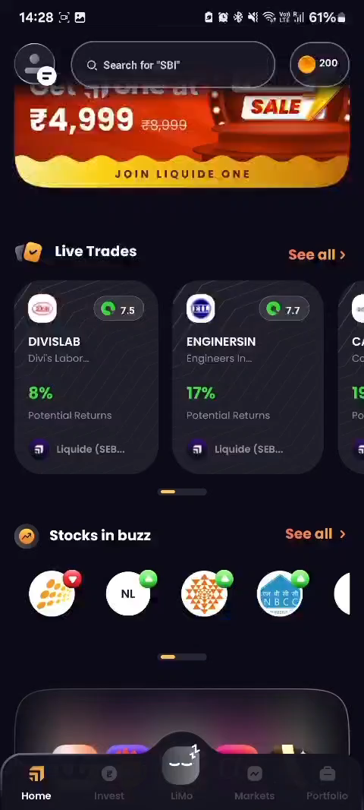
Key Features
Stock Market Trading Recommendations
Portfolio Health Analysis
Al-Powered Bot – LiMo
IPO Verdicts
Watchlist Stocks and Stock Alerts
Stock insights and Market Sentiment
Academy
Stock Baskets
Live Trade Recommendations
Notes:
Offers curated stock trading recommendations for quick wins, short-term, mid-term, and long-term trades, backed by stock market analysis

Slide 5
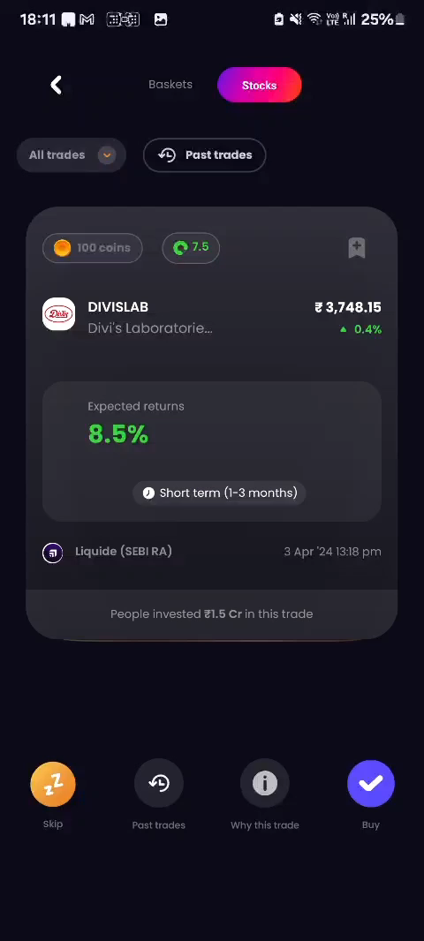
Key Features
Stock Market Trading Recommendations
Portfolio Health Analysis
Al-Powered Bot – LiMo
IPO Verdicts
Watchlist Stocks and Stock Alerts
Stock insights and Market Sentiment
Academy
Stock Baskets
Past Trades

Slide 6
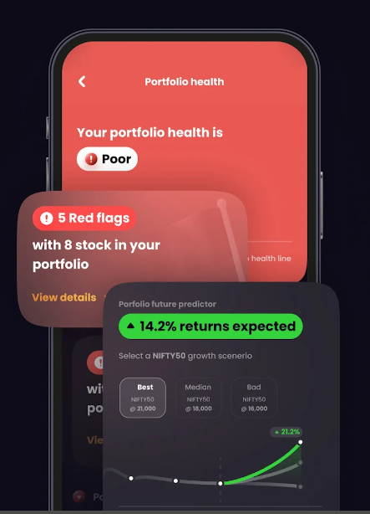
Key Features
Stock Market Trading Recommendations
Portfolio Health Analysis
Al-Powered Bot – LiMo
IPO Verdicts
Watchlist Stocks and Stock Alerts
Stock insights and Market Sentiment
Academy
Stock Baskets
Notes:
Provides insights into investment portfolios by connecting with broker accounts, identifying potential red flags, and ensuring sector diversification

Slide 7
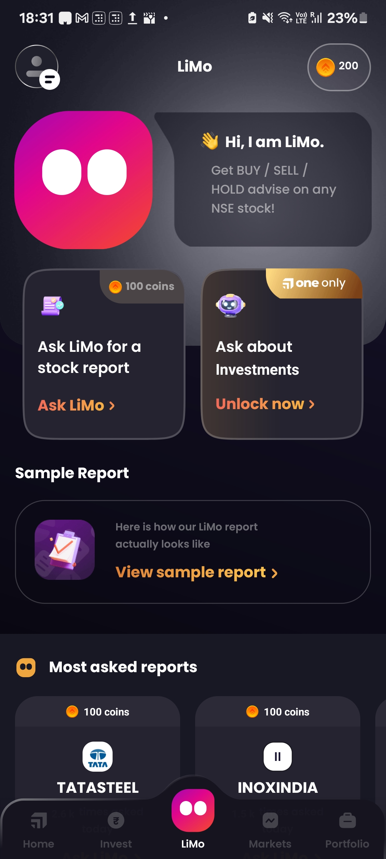
Key Features
Stock Market Trading Recommendations
Portfolio Health Analysis
Al-Powered Bot – LiMo
IPO Verdicts
Watchlist Stocks and Stock Alerts
Stock insights and Market Sentiment
Academy
Stock Baskets
Notes:
An AI-powered BOT offering real-time BUY/SELL/HOLD ratings for stocks, serving as an intraday trading companion

Slide 8
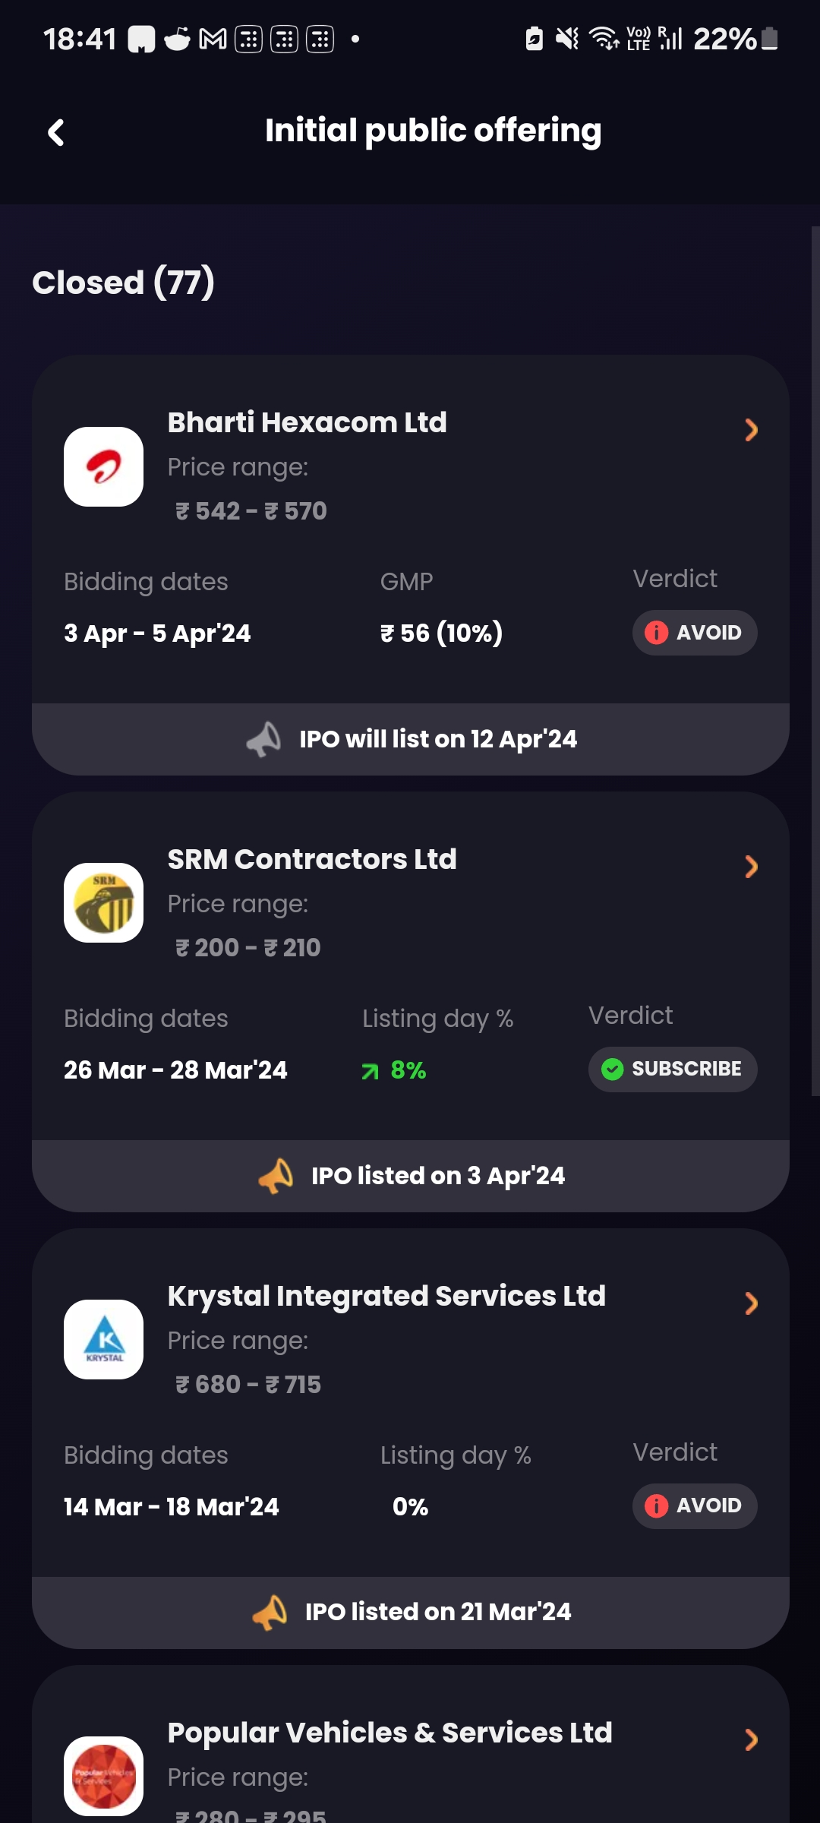
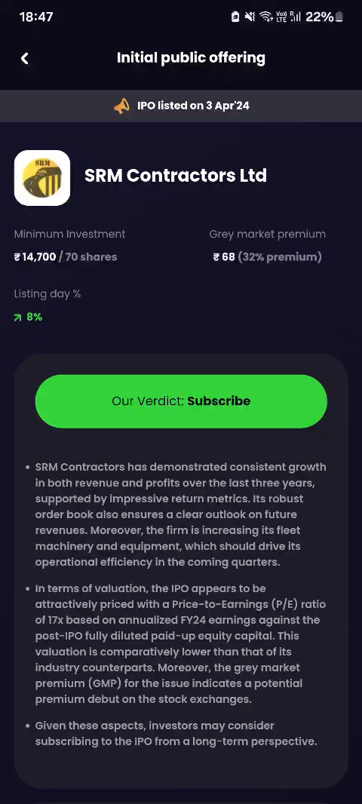
Key Features
Stock Market Trading Recommendations
Portfolio Health Analysis
Al-Powered Bot – LiMo
IPO Verdicts
Watchlist Stocks and Stock Alerts
Stock insights and Market Sentiment
Academy
Stock Baskets
Notes:
Offers expert insights on upcoming Initial Public Offerings (IPOs) to help investors make informed decisions

Slide 9
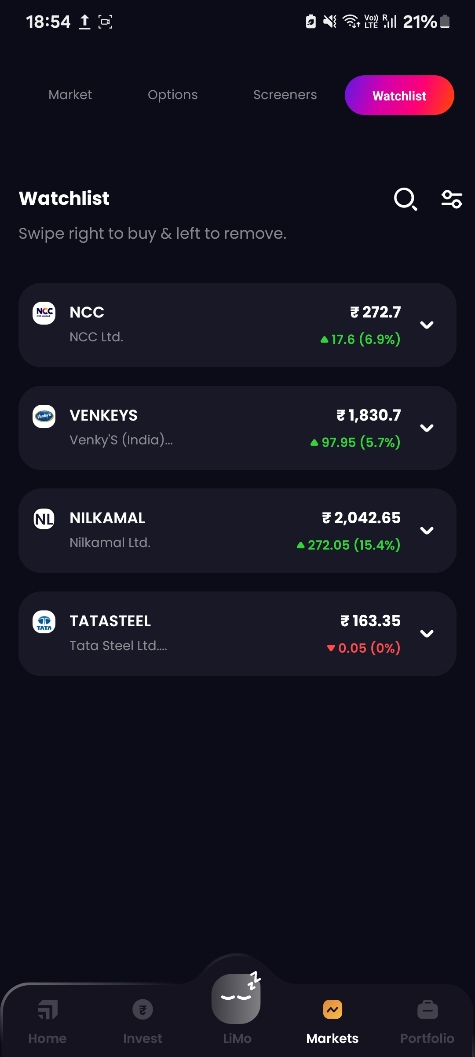
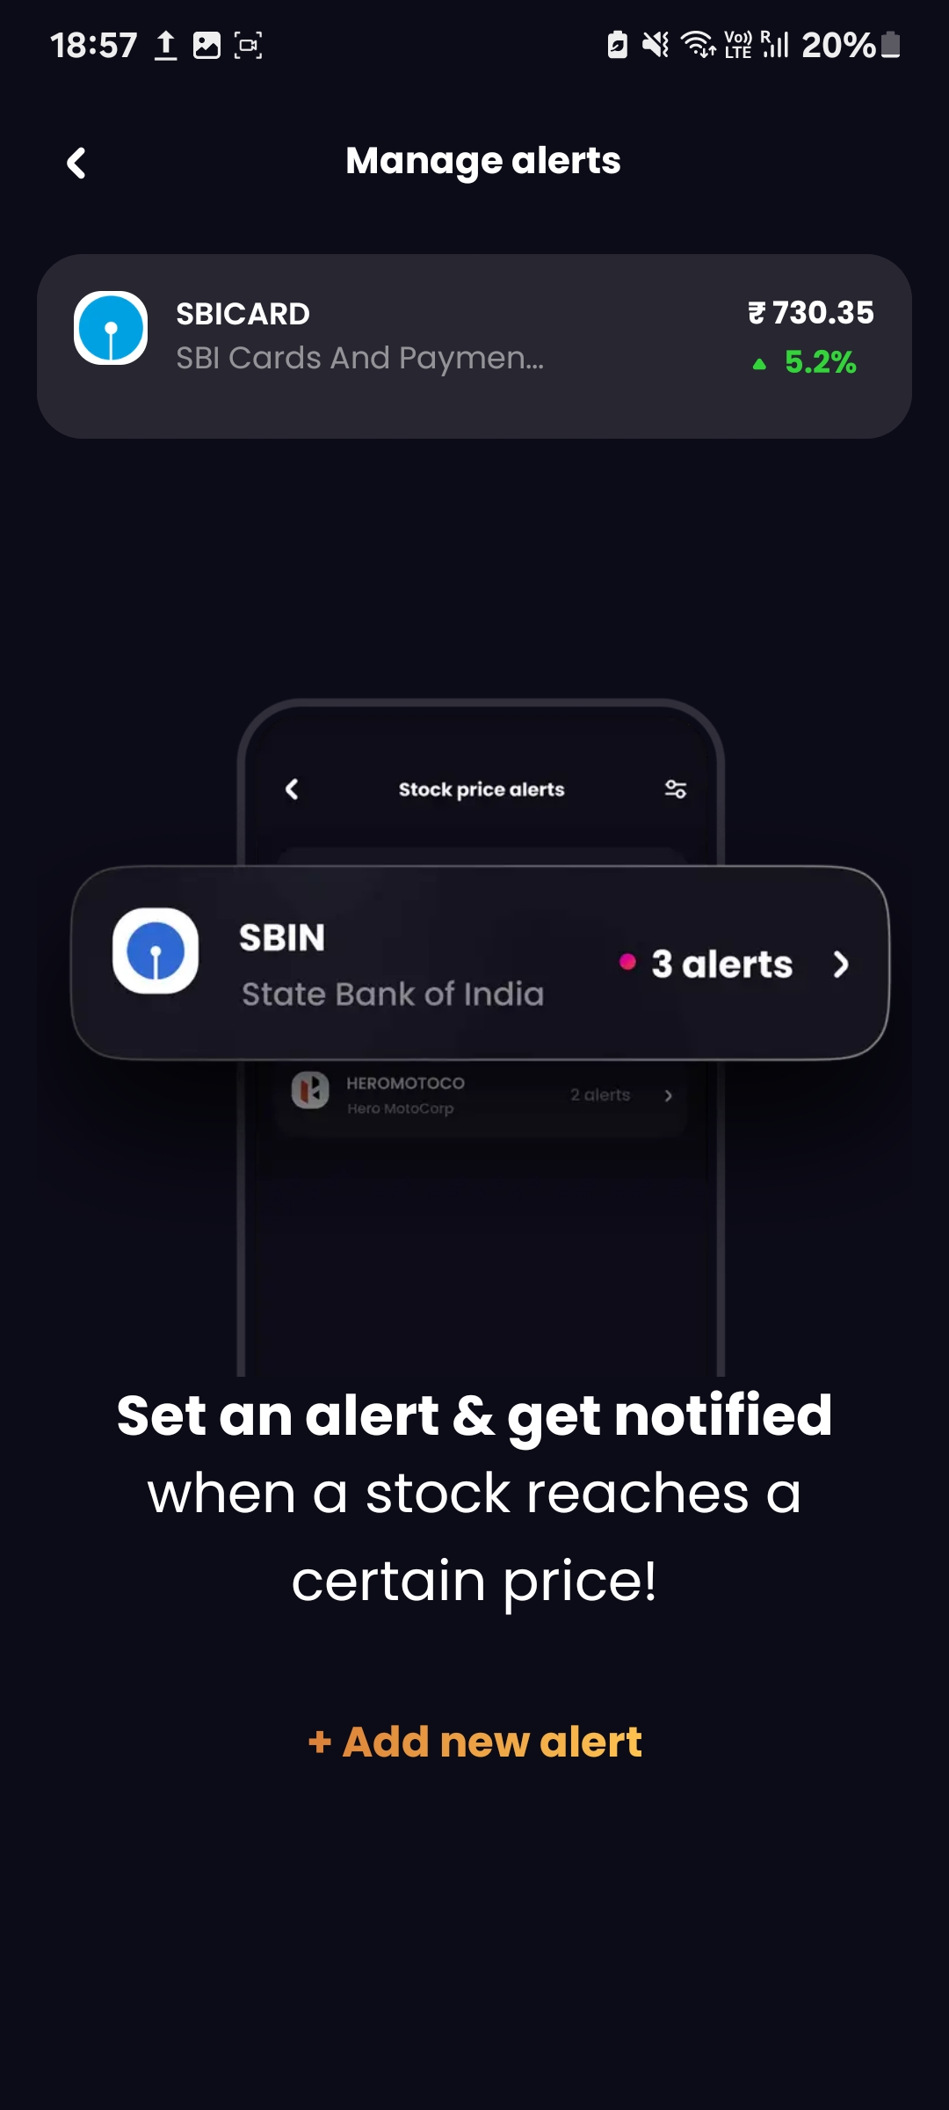
Key Features
Stock Market Trading Recommendations
Portfolio Health Analysis
Al-Powered Bot – LiMo
IPO Verdicts
Watchlist Stocks and Stock Alerts
Stock insights and Market Sentiment
Academy
Stock Baskets
Notes:
Allows users to track favorite stocks and set personalized price alerts

Slide 10
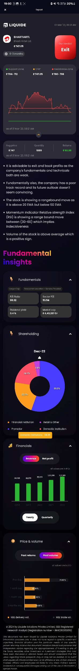
Key Features
Stock Market Trading Recommendations
Portfolio Health Analysis
Al-Powered Bot – LiMo
IPO Verdicts
Watchlist Stocks and Stock Alerts
Stock insights and Market Sentiment
Academy
Stock Baskets
Notes:
Provides real-time news signals, detailed stock insights, and a daily pulse on the market sentiment

Slide 11
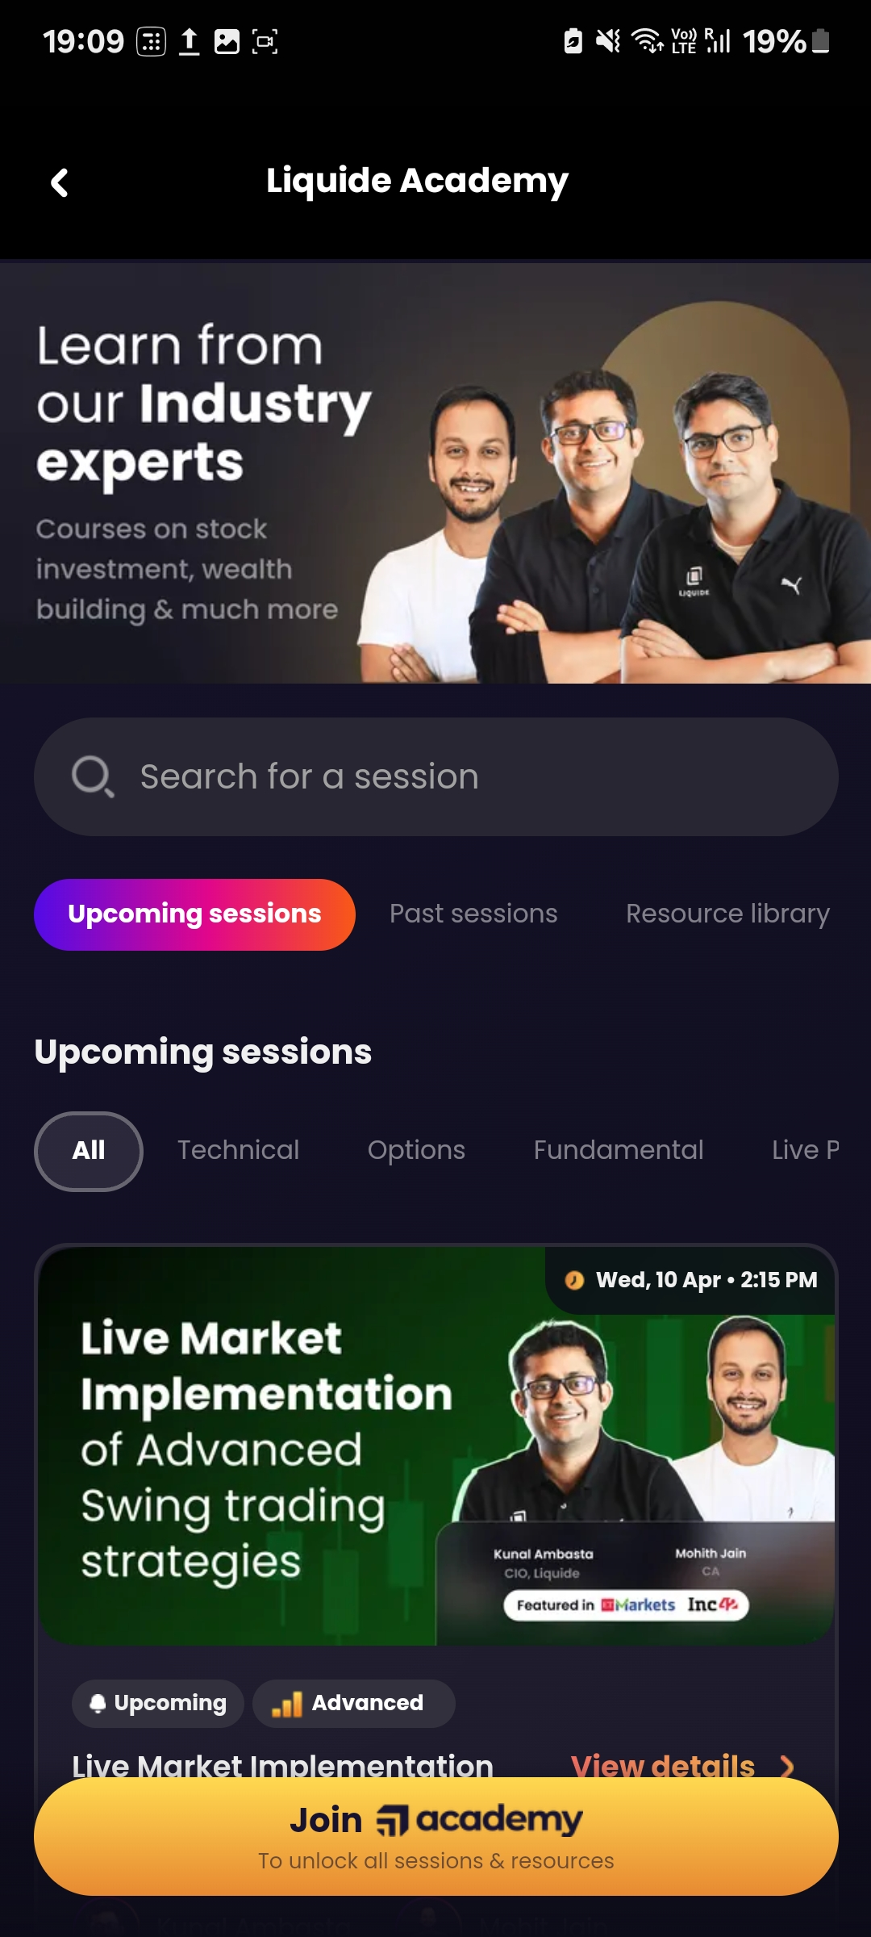
Key Features
Stock Market Trading Recommendations
Portfolio Health Analysis
Al-Powered Bot – LiMo
IPO Verdicts
Watchlist Stocks and Stock Alerts
Stock insights and Market Sentiment
Academy
Stock Baskets
Notes:
Offers over 100 hours of in-depth stock market courses to enhance investment knowledge

Slide 12
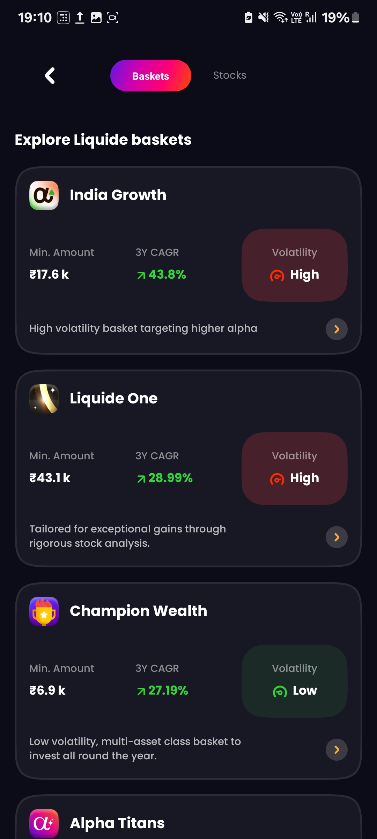
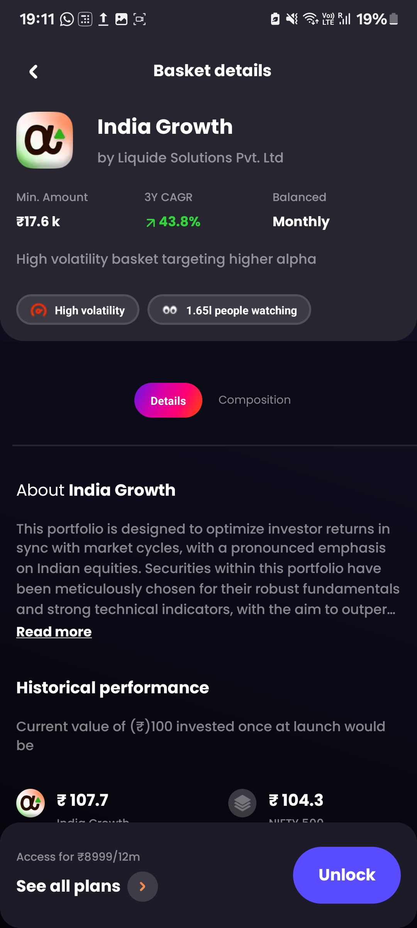
Key Features
Stock Market Trading Recommendations
Portfolio Health Analysis
Al-Powered Bot – LiMo
IPO Verdicts
Watchlist Stocks and Stock Alerts
Stock insights and Market Sentiment
Academy
Stock Baskets
Notes:
Features expertly curated stock baskets crafted by SEBI-certified professionals, making investing accessible to everyone

Slide 13
LiMo – Liquide Solution’s AI Powered chat assistant
Realtime portfolio Analysis
Stock insights and Live Market News
BUY/SELL/HOLD Recommendation
Educational Content
Limo can analyze your portfolio in real-time, offering insights into your investments and suggesting potential improvements or red flags.
It provides detailed stock insights and live market news, helping users stay informed about the stocks they hold or are interested in.
Based on your investment goals, Limo offers personalized BUY, SELL, or HOLD recommendations for stocks.
Limo is equipped to answer unlimited questions about stocks, trading concepts, and more, serving as a valuable educational tool for investors.

Slide 14
Product Performance
Subscription Model: Liquide One
Feb 2023 : 300k
As of 24 Aug’ 22 - Over 2 Mn retail DEMAT accounts have been added since 2020
1.3M+
Downloads
4.8
Avg. Store Rating
1.5 Mn+
Stock Queries Answered
~80%
Success rate

Slide 15
Multipl
Multipl FinTech Solution Private Limited

Slide 16
Introduction
Tackling negative spending behaviours associated with products like BNPL, credit cards
SEBI registered investment advisory
SEBI Reg. No. INA200014681
Launched in
December 2020
Founders
Padmanabhan Raghavan, Vikas Subodh Jain, Jagannathan Raghavan
Business Model
B2C, B2B2C
Target Audience
Salaried Employees (2 Crores)

Slide 17
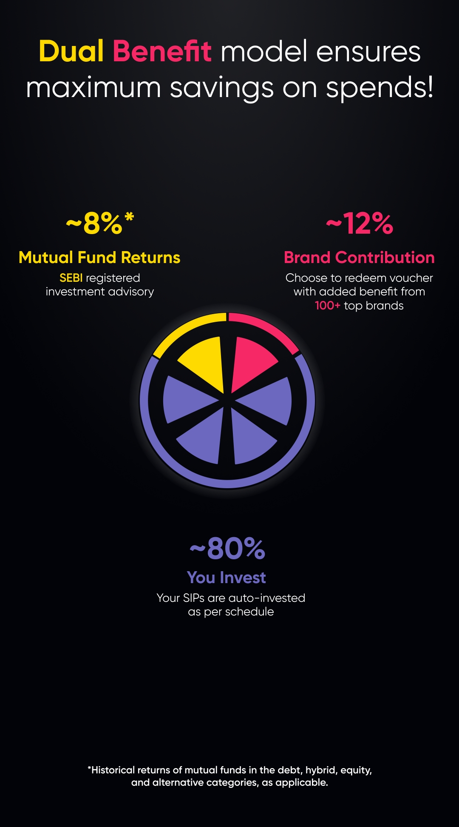
Spendvesting Strategy
SPEND + INVESTING
Merging lifestyle goals with prudent investing
Save around 20% on their lifestyle spends
Targeting GenZ: 50% of India’s spendvestors

Slide 18
Creating a goal on Multipl
Choose between planned and Spontaneous Spend
Select a spend category
Set a spend amount
Set the amount of months you want to save up for.

Slide 19
Dual Benefit Model
Currently partnering with 70+ brands and 100+ reward partners
Travel: MakeMyTrip & EaseMyTrip
Gadget: Amazon & TataCliq
Shopping: Ajio, Westside, Fabindia, & Decathlon
Essentials: Swiggy, Uber, Zomato, Urban Clap, & Cultfit
These partnerships allow you to redeem your investments with added contributions from these brands, leading to more savings when you make purchases through them.
Multipl offers customers the following investment options:
1. Mutual Funds: Personalized mutual fund investments based on your risk profile and goals, with historically 8-12% annual returns.
2. Digital Gold: Daily investing option where you can start with a small amount and your money is invested in digital gold
These options are designed to cater to both short-term and long-term financial goals, providing flexibility and potentially higher returns compared to traditional savings.

Slide 20
Other Key Features
Purchase Protection Guarantee: Offers peace of mind with a minimum assured redemption amount when you spend with brand partners, safeguarding against market volatility.
Auto-Pay Options: Set up bank or UPI Auto-Pay for seamless SIPs towards your goals.
Curated Investment options: The investment options are curated by Multipl's team of SEBI registered investment advisors. They use a combination of over 25 quantitative and qualitative criteria to select suitable funds from over 1500 direct schemes. This ensures that the chosen investment options align with the long-term performance, expense ratios, exit loads, and fund philosophy, aiming to optimize risk-adjusted returns for users.
KYC Compliance: Complete your KYC within the app to start investing.
No Subscription Fees: There are no subscription charges; you invest directly through the app.
Safety and Liquidity: Investments are managed with a focus on safety, liquidity, and returns (SLR model).
Insurance:

Slide 21
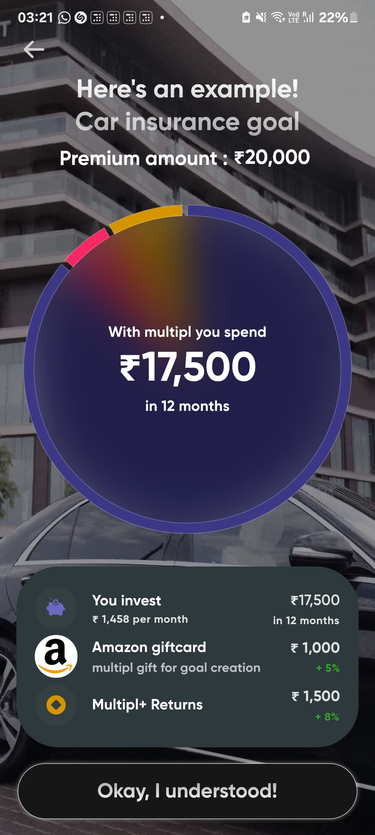
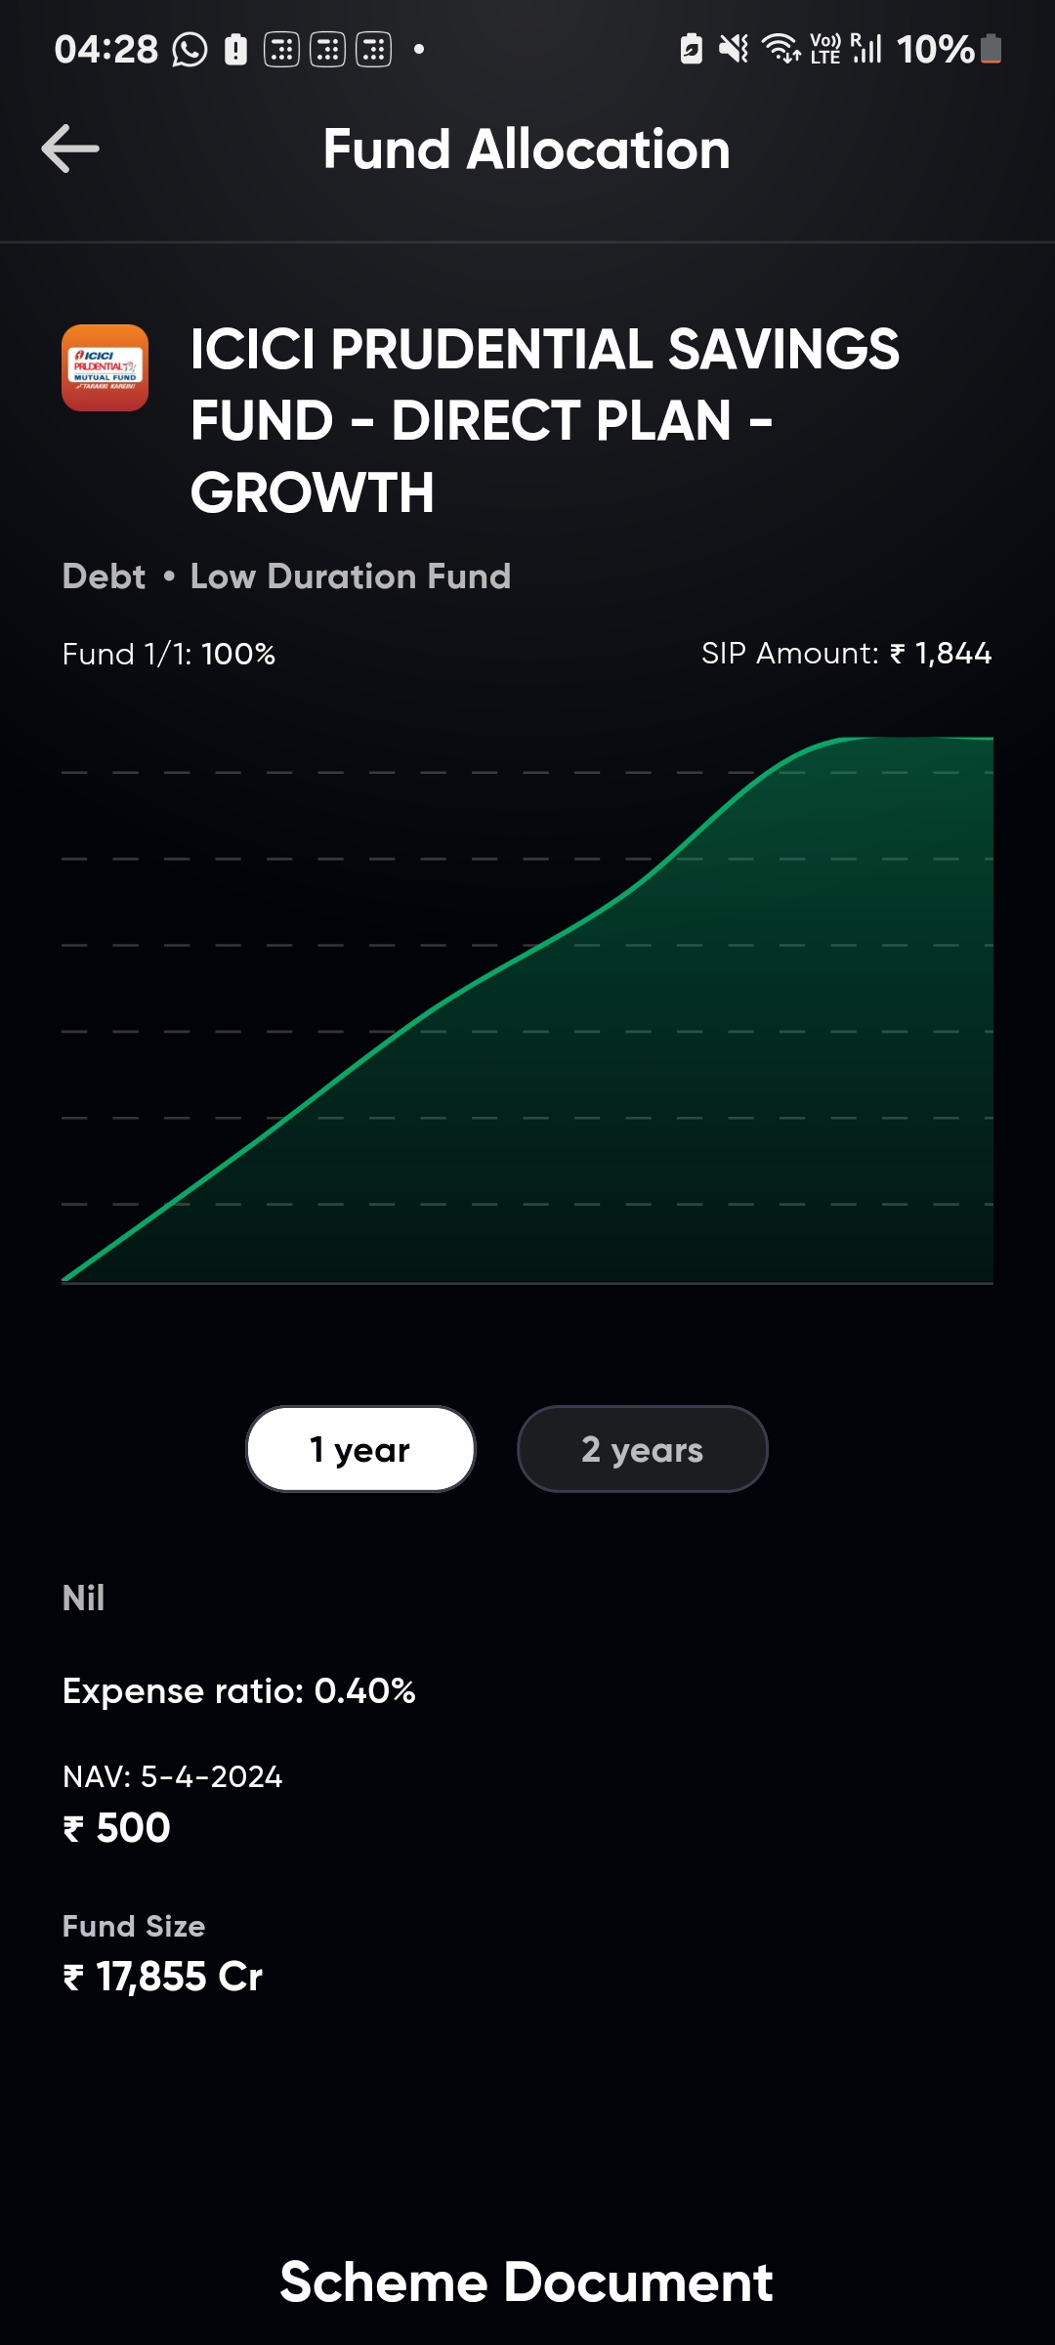

Slide 22
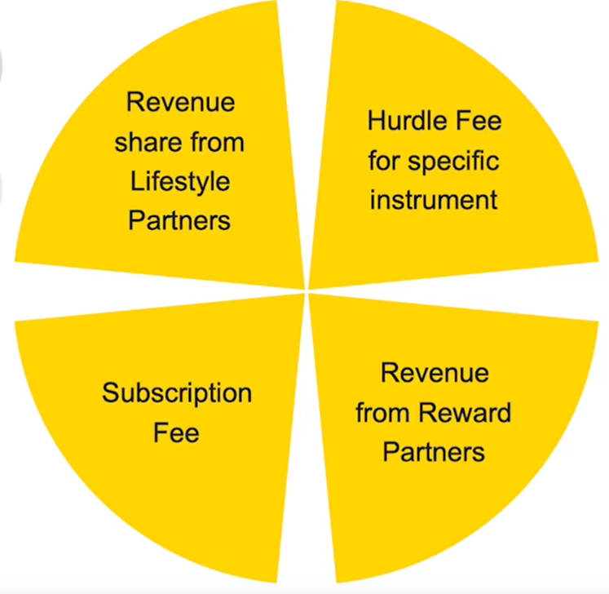
Business Model

Slide 23
Performance
Total Funding
$3.79M
User Base
500k
Average Store Rating
4.3
Notes:
Date | Amount | Round | New Investors
May 02, 2022 | $3M | Seed | Blume, GrowX Ventures
Dec 28, 2021 | $225K | Seed | QED Innovation Labs, YourStory
Dec 31, 2020 | $568K | Angel | Padmapriya Srirangarajan, Nikhil S

